Slide 1
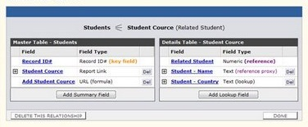



Creating Data-Driven ASP.NET Web Applications
Ventsislav Popov
Crossroad Ltd.

Slide 2

Table of Contents
ASP.NET Data Source Controls
SqlDataSource
EntityDataSource
ObjectDataSource
Entity Data Model and ADO.NET Entity Framework
Using ASP.NET Data Source Controls
Editable Controls
Master-Detail Navigation
Notes:
Бележки на автора:
Съдържание - Контроли

Slide 3
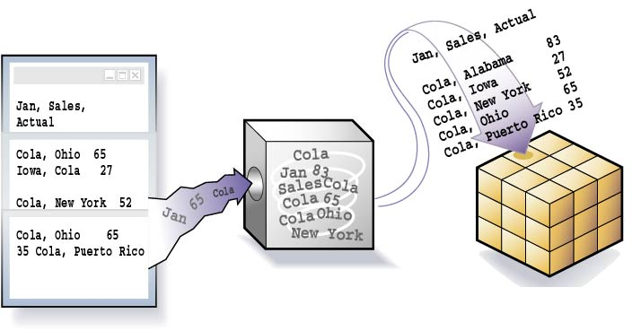

ASP.NET Data Source Controls
Notes:
Data Source controls are new server controls that performs the core task of connecting to a data source, handles all database related tasks like reading, writing and updating the data. It acts as coordinator between underlying different physical data sources at data access layer and data bound controls like GridView, DataGrid at presentation layer. These new Data Source controls are built with features like sorting, paging, editing and updating data directly in data source. You can seamlessly integrate these features into your application with out writing any custom code

Slide 4
ASP.NET Data Source Controls
ASP.NET provides server controls that take care of data binding details
Known as data source controls
SqlDataSource, EntityDataSource, ObjectDataSource, …
They are an abstraction over the data source
Data-bound server controls can be associated to a data source control
Through the DataSourceID property

Slide 5
SqlDataSource
SqlDataSource provides connection to a relational DB (MS SQL Server, Oracle, …)
Data is manipulated by using commands
Select, Update, Insert and Delete
Commands can be either SQL queries or names of a stored procedures
Data is processed with a DataSet (by default)
The DataSourceMode property specifies whether to use DataSet or DataReader
Notes:
You can display, edit, and sort data on a Web page with little or no code.
To connect to a database, you must set the ConnectionString property to a valid connection string. The SqlDataSource can support any SQL relational database that can be connected to using an ADO.NET provider, such as the SqlClient, OleDb, Odbc, or OracleClient provider
Select method is automatically called by controls that are bound to the SqlDataSource when their DataBind method is called
If you display data on your page using a SqlDataSource control, you can increase the performance of the page by using the data caching capabilities of the data source control. Caching reduces the processing load on the database servers at the expense of memory on the Web server; in most cases, this is a good trade-off.
There is no visual rendering of the SqlDataSource control; it is implemented as a control so that you can create it declaratively and, optionally, to allow it to participate in state management.

Slide 6
SqlDataSource – Example
<asp:GridView ID="GridViewCustomers" runat="server"
DataSourceID="SqlDataSourceNorthwind">
</asp:GridView>
<asp:SqlDataSource ID="SqlDataSourceNorthwind"
runat="server" ConnectionString=
"<%$ ConnectionStrings:NorthwindConnectionString %>"
SelectCommand="SELECT [CompanyName], [ContactName],
[PostalCode], [Phone], [Address] FROM [Customers]">
</asp:SqlDataSource>
Note that your SQL is the presentation layer
Mixing presentation and database logic is very bad practice, so use SqlDataSource!

Slide 7



Using SqlDataSource
Live Demo

Slide 8
Entity Data Model
EDM (Entity Data Model): conceptual Entity-Relationship data model
Entity: instances of Entity Types (e.g. Employee, SalesOrder) with an unique key, grouped in Entity-Sets.
Relationship: associate entities, and are instances of Relationship Types (e.g. SalesOrder posted-by SalesPerson), grouped in Relationship-Sets.
Notes:
0) The logical database schema is not always the right view of the data for a given application
1) Central concepts in the EDM are entities and relationships. Entities are instances of Entity Types (e.g., Customer, Employee) which are richly structured records with a key. An entity key is formed from a subset of properties of the Entity Type. The key (e.g., CustId, EmpId) is a fundamental concept to uniquely identify and update entity instances and to allow entity instances to participate in relationships. Entities are grouped in Entity Sets (i.e., Customers is a set of Customer instances). Relationships are instances of Relationship Types which are associations among two or more entity types (e.g., Employee WorksFor Department). Relationships are grouped in Relationship Sets.
2) Model and manipulate data at a level of structure and semantics that is closer to the business domain

Slide 9
ADO.NET Entity Framework
ADO.NET EF: manages the transformations between the logical database in the relational store and the conceptual EDM.
Generates an XML representation of a conceptual to logical mapping
ADO.NET client-views adapt the data to a shape that makes sense for the application without affecting the actual database
Querying Against an EDM Model (eSQL)
Notes:
0) In order to provide a mechanism for storing data modeled using the EDM in relational databases, the ADO.NET Entity Framework houses a powerful client-views infrastructure designed to manage the transformations between the logical database schema that's present in the relational store and the conceptual EDM schema used by the application.
- An ideal environment for creation of business applications should allow developers to describe the business logic and state of the problem domain which they are modeling with minimum or no "noise" coming from the underlying representation and the infrastructure that supports it
- No artificial constructs; No plumbing
When the mapping tool is used to create a conceptual to logical mapping, it produces an XML file that can be consumed by the run-time components of the ADO.NET Entity Framework. The appendix includes the XML representation of the mapping. Fortunately, tools will make it unnecessary for the vast majority of users to have to understand or deal with these XML files.
When an application uses an EDM model and the mapping provider to access it, it no longer connects directly to a database or sees any database-specific construct; the entire application operates in terms of the higher-level EDM model. In order to enable query against EDM models, the ADO.NET Entity Framework introduces a query language that's designed to work with the EDM and can leverage the full expressivity of the entity data model. The language is called Entity SQL and it should look familiar to all developers that have used some SQL dialect before

Slide 10
EntityDataSource
The EntityDataSource - data binding in Web applications that use the ADO.NET EF
Part of the .NET Framework 3.5, beginning with SP1 and above
Manages create, read, update, and delete operations against a data source on behalf of data-bound controls
The Entity Data Model Designer supports creating mapping scenarios
Notes:
The ADO.NET EntityDataSource control supports data binding scenarios in Web applications that use the ADO.NET Entity Framework.
Like the Entity Framework, the control is available as part of the .NET Framework 3.5, beginning with SP1.
Like the other Web server data source controls, the EntityDataSource control manages create, read, update, and delete operations against a data source on behalf of data-bound controls on the same page. The EntityDataSource works with editable grids, forms with user-controlled sorting and filtering, dually bound drop-down list controls, and master-detail pages.
The EntityDataSource control runtime and designer both ship with the .NET Framework. The EntityDataSource control is automatically registered with the toolbox and included in the data control group with the other Microsoft data source controls.

Slide 11
EntityDataSource Pros And Cons
Pros
The schema can be automatically updated for underlying changes made to the database structures.
TIMESTAMP concurrency is supported
Cons
Views which do not have any underlying unique keys are not able to be added to the data model

Slide 12
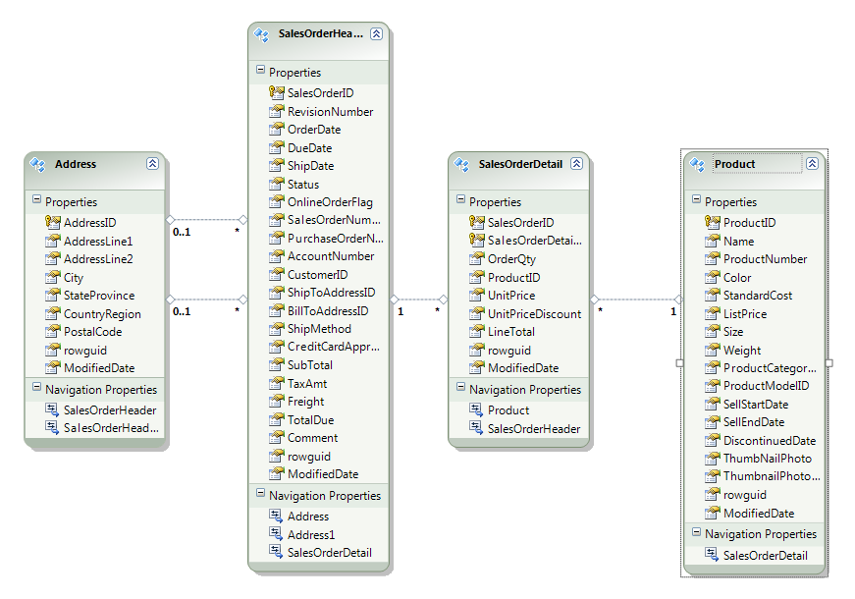
EntityDataSource – Example
Define the data model (e.g. Entity Data Model)
Create a basic listing (e.g. ListBox)
<asp:ListBox ID=“lBoxOrderHeaders" runat="server">
</asp:ListBox>

Slide 13
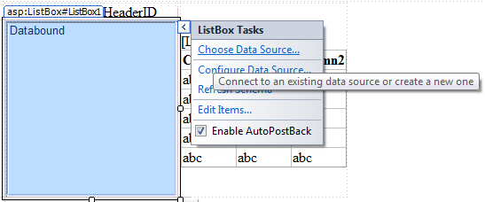
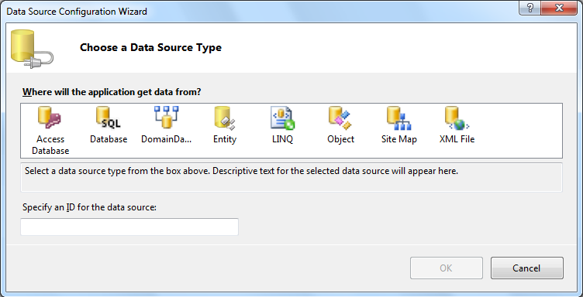
EntityDataSource-Example (2)
Bind the ListBox to the data model
Select the new "Entity" option in the dialog box

Slide 14
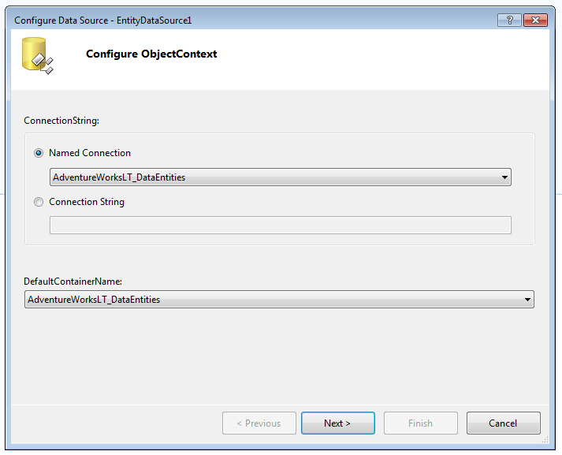
EntityDataSource-Example (3)
Designer will then display the available Entity Containers

Slide 15
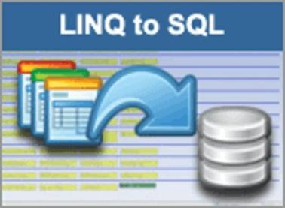

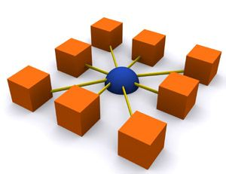
Using EntityDataSource
Live Demo

Slide 16
ObjectDataSource
ObjectDataSource enables data-binding of UI control to an object
Instead of directly binding to a database
Needs a middle-tier business object
Data manipulation is based on methods
TypeName – name of the business object
DataObjectTypeName – a class holding the Select, Update, Insert, Delete methods
SelectMehtod, UpdateMethod, …
Notes:
1) Represents a business object that provides data to data-bound controls in multitier Web application architectures.
2) A very common application design practice is to separate the presentation layer from business logic and to encapsulate the business logic in business objects. These business objects form a distinct layer between the presentation layer and the data tier, resulting in a three-tier application architecture. The ObjectDataSource control enables developers to use an ASP.NET data source control while retaining their three-tier application architecture.
3) The ObjectDataSource control creates and destroys an instance of the class for each method call; it does not hold the object in memory for the lifetime of the Web request. This is a serious consideration if the business object that you use requires many resources or is otherwise expensive to create and destroy
4 )Although the ObjectDataSource does not retain the instance of the business object across multiple requests, it can cache the result of the SelectMethod property.

Slide 17
ObjectDataSource – Example
<asp:ObjectDataSource ID="dsProducts"
runat="server" TypeName="ObjectDataSourceProducts"
DataObjectTypeName="Product"
SelectMethod="GetAll" InsertMethod="Insert"
UpdateMethod="Update" DeleteMethod="Delete">
</asp:ObjectDataSource>
<asp:GridView ID="GridViewProducts" runat="server"
DataSourceID="dsProducts" DataKeyNames="ProductID">
</asp:GridView>

Slide 18



Using ObjectDataSource
Live Demo

Slide 19
ObjectDataSource with Entities-to-SQL, ListView and FormView
Define the data model (Entities to SQL)
Add new class Categories
Add method GetAllCategories in the Categories class
public static DataClassesObjectContext objectContext =
new DataClassesObjectContext();
public static IQueryable<Category> GetAllCategories()
{
var categories =
from category in dataContext.Categories
orderby category.CategoryName select category;
return categories;
}

Slide 20
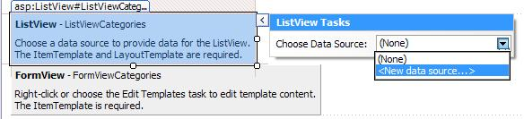
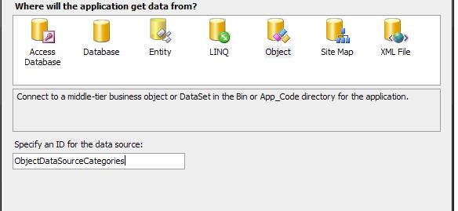
ObjectDataSource with LINQ-to-SQL, ListView and FormView (2)
Add ListView and FormView controls to the aspx page
Bind the ListView to the ObjectDataSource

Slide 21
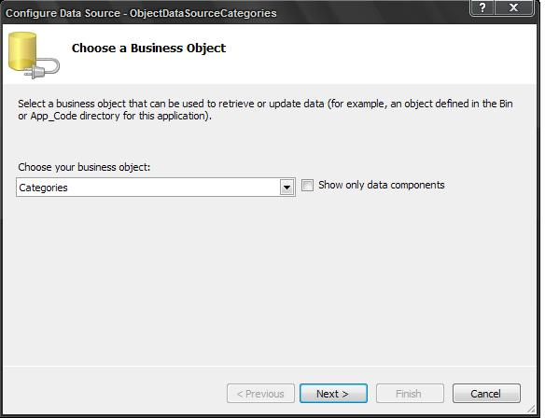
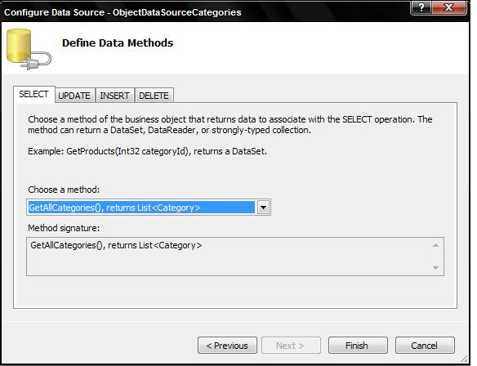
ObjectDataSource with LINQ-to-SQL, ListView and FormView (3)
Next choose your custom class Categories
And choose method GetAllCategories

Slide 22
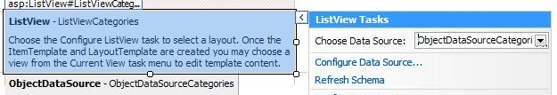
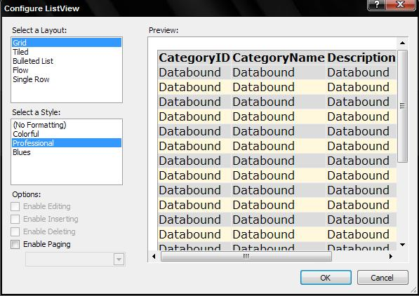
ObjectDataSource with LINQ-to-SQL, ListView and FormView (4)
Click to configure the ListView control
Optionally choose layout and style

Slide 23
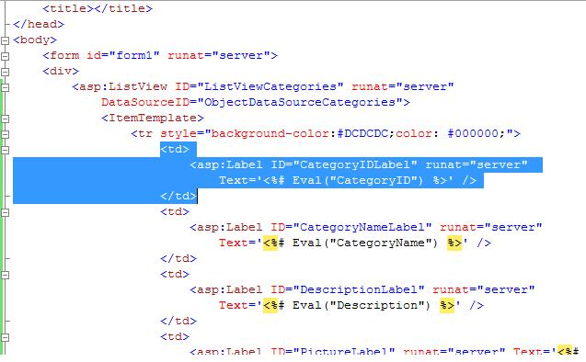
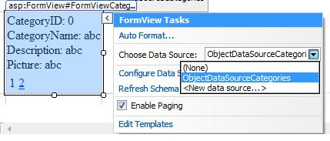
ObjectDataSource with LINQ-to-SQL, ListView and FormView (5)
Delete from all templates the row which represent pictures
Bind the FormView to ObjectDataSource and enable paging

Slide 24
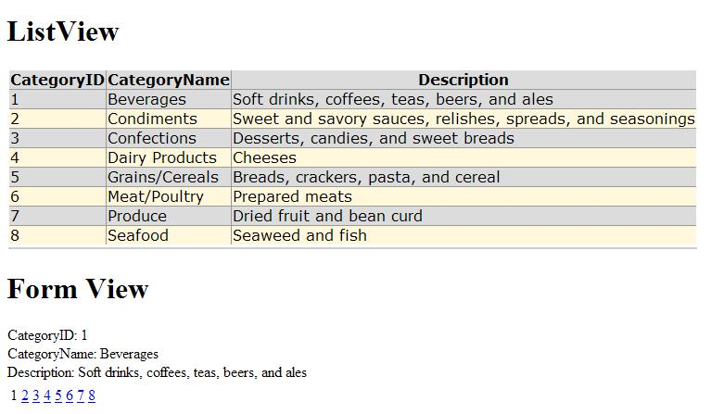
ObjectDataSource with LINQ-to-SQL, ListView and FormView (6)
The result is:

Slide 25
Other Data Sources
LinqDataSource
Hierarchical
XmlDataSource
Establishes a connection to an XML source of data (files, documents)
DataFile, TranformFile, XPath
SiteMapDataSource
MS Access - AccessDataSource
Derives from SqlDataSource
DataFile
Notes:
1) LinqDataSource: Enables you to use Language-Integrated Query (LINQ) in an ASP.NET Web page through declarative markup in order to retrieve and modify data from a data object. Supports automatic generation of select, update, insert, and delete commands. The control also supports sorting, filtering, and paging.
2) XMLDataSource: Enables you to work with an XML file, especially for hierarchical ASP.NET server controls such as the TreeView or Menu control. Supports filtering capabilities using XPath expressions and enables you to apply an XSLT transformation to the data. The XmlDataSource allows you to update data by saving the entire XML document with changes.
3) SiteMapDataSource: Used with ASP.NET site navigation
4) Enables you to work with a Microsoft Access database. Supports sorting, filtering, and paging when data is returned as a DataSet object.

Slide 26

Creating Data-Driven ASP.NET Web Applications
Questions?

Slide 27
Exercises
Create a Web form that contains a GridView control. Bind it to the Categories table from the Northwind database using LinqDataSource and LINQ to SQL data context classes. Implement selection, editing and deleting of rows. Enable sorting and paging.
Implement inserting of new categories by adding a FormView control bound to the same data source.
Reimplement the same functionality with ObjectDataSource.

Slide 28
Exercises (2)
Using LinqDataSource, ASP.NET data-bound controls and LINQ to SQL create a Web application to display information about towns and countries stored in SQL Server database. Each country has name, language, national flag and list of towns. Each town has name, population and country. Use a set of text boxes to show a single country in the left side of the main form along with navigation buttons (Next / Previous) to change the currently selected country. Use GridView on the right side of the form for the towns of the currently selected country. When the current country changes, load and display its towns.

Slide 29
Exercises (3)
Add to the system a new information object: continents. Countries are considered to reside in exactly one of the continents. Use ListBox to display the continents. Implement master-detail navigation: when a continent is selected, its corresponding countries are loaded. When a country is selected, its towns should be loaded.
Implement editing of all information objects in the system (add / edit / delete). Implement adding as a separate .aspx page.

